Slide 1
Weed Recognition Using CNN
Applied Artificial Intelligence
Vandan Chauhan

Slide 2
Weeds?
Species of unwanted plants or grass that grow around a useful plant, such as crops (Not to be confused with Weed!).
The peculiarity of weeds is that they don’t need to be grown, they grow by themselves.
Even in Saskatchewan’s snowy weather, the weeds are able to grow by themselves after a snowy season.

Slide 3
Why do they need to be recognized?
Spread prevention.
Controlling evolution of species.
Identification of age.
Life cycle analysis.
For further applications in Weed detection.

Slide 4
Solutions?
If the weeds are to be removed, it has to be done either manually, chemically, or by using machines.
The machine way has much labour too, instead this can be automated.
For a machine to be able to detect weeds, several methods can be used.
One of those methods is to recognize weeds from images.

Slide 5
The Project

Slide 6
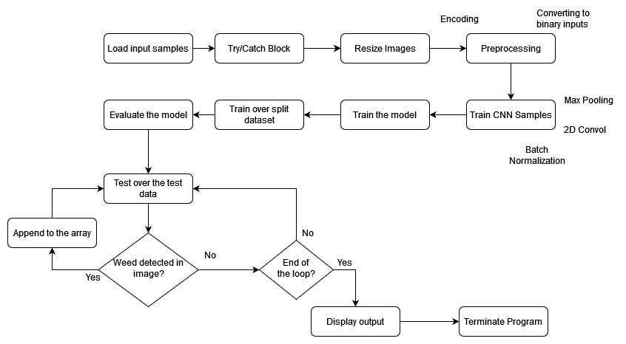
Structure

Slide 7
The dataset
Dataset: Plant-Seedlings Classification, source: Kaggle Datasets
4750 images for training, 794 for testing. (A 6:1 ratio)
Images of 12 different kinds of species of weeds.
Images taken for a collaborative experiment, between Aarhus University, Denmark, and University of Southern Denmark.
Different resolutions, aspect ratio 1:1.
Taken at various stages of the life cycle of a weed, to have varied images.

Slide 8
The CNN way
There are several algorithms that can be used for image detection and identification.
CNN is widely used for image and video recognition, recommender systems, image classification, image segmentation, medical image analysis, natural language processing, etc.
CNN which is a class of ANN, is commonly used to analyze visual imagery.

Slide 9
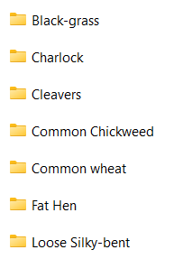
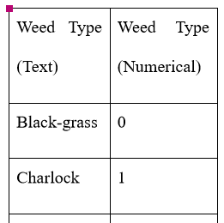
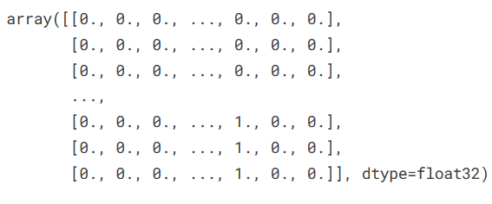
Preprocessing
Label Encoder is used, converts the text data of directory (classes) to numerical.
The values of directories are converted to a binary matrix.
Images are resized to 128 x 128, RGB format, using OpenCV.
Layers are passed sequentially, using sequential function.
Split the training dataset into test+train, using SkLearn’s train_test_split.

Slide 10
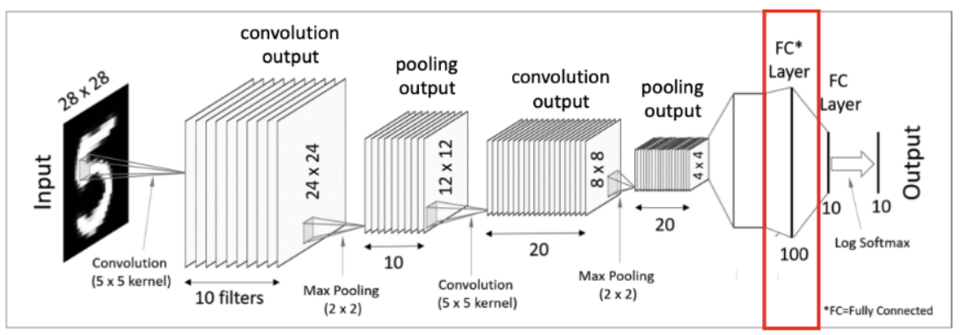
CNN model
Works on image matrices.
Majority of functions are derived from Keras library (models), with some from SkLearn(data analysis) and TensorFlow(numerical processing).
Uses 2D Convolution, with ReLU activation.
Max Pooling: Chooses the maximum value over a pool (window).
Other functions such as Batch Normalization, Dense(with softmax) - to connect layers better, Dropout - to prevent overfitting; are used.
Image source: https://www.kaggle.com/code/inyeongkang/simple-cnn-keras-for-beginners

Slide 11
Training the model
The model is trained over the training images for 30 epochs, for a batch size of 100.
The split of the dataset, is used as validation data to train the model for one more time.
For the 2nd run, there are 30 epochs, with a batch size of 100 as well.

Slide 12
Evaluation & Comparison
The trained model is evaluated, and loss and accuracy are given.
The model demonstrated an accuracy of 98.86%.
Other model’s approach-accuracy-epochs | Our Model
Similar approach+Early Stopping-95.89%-30 | With Dropout, no Early stopping- 98.86%
Real-time images(or on field)- 99.87%-50 | Used laboratory images.

Slide 13
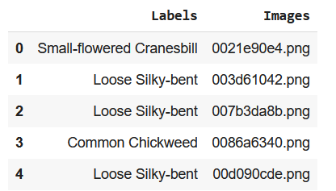
Prediction
The model is made to predict with the image in the testing dataset, and displayed the classes of the images as per their class.

Slide 14
Code Demo

Slide 15
Conclusion & Future Works
The model can be used for recognition. However, since this dataset had images from a laboratory, there might be issues if this model is made to recognize real-time images.
This model can be trained for real-time recognition if necessary.
There are several model that have already been developed, along with physical components.

Slide 16
References
An unique model for weed and paddy detection using regional convolutional neural networks- https://www.tandfonline.com/doi/full/10.1080/09064710.2021.2011395
RoboWeedSupport - Detection of weed locations in leaf occluded cereal crops using a fully convolutional neural network- https://www.proquest.com/docview/1904073750?accountid=13480&parentSessionId=Bd5ubjJLtaUBXY1pX32bEn7KLujuCrOy51PY9DmfXhU%3D&pq-origsite=primo
Detection of Grassy Weeds in Bermudagrass with Deep Convolutional Neural Networks- https://www.proquest.com/docview/2448807919?

Slide 17
Thank you

